Slide 1
Employee Data Analysis using Excel
STUDENT NAME:KHADER BASHA.A
REGISTER NO : 312202056
DEPARTMENT :B.COM GENERAL
COLLEGE : MOHAMED SATHAK COLLEGE OF ARTS AND SCIENCE SHOLLINGANALLUR, CHENNAI

Slide 2
PROJECT TITLE
Employee Performance Analysis using Excel

Slide 3


AGENDA
Problem Statement
Project Overview
End Users
Our Solution and Proposition
Dataset Description
Modelling Approach
Results and Discussion
Conclusion
3/21/2024 Annual Review

Slide 4

PROBLEM STATEMENT
A large dataset of employee information in Excel, including personal details, job roles, performance metrics, and attendance records. Despite having this data, we face challenges in efficiently analyzing- and leveraging this information for decision-making.

Slide 5

PROJECT OVERVIEW
It is a summary of employee dataset analysis the performance of various employees by consulting the various factors like employee type current emploi rating employee status and business unit gender and raw labels and future starts and there achievements said to be the employee performance analysis in order to check the trains and different categories like high medium low performance level of the employees

Slide 6
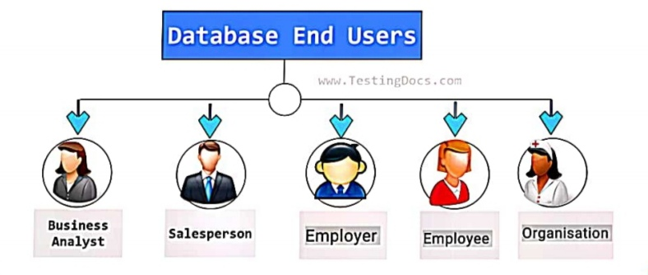

WHO ARE THE END USERS?

Slide 7

OUR SOLUTION AND ITS VALUE PROPOSITION
Conditions Formatting – Missing
Filter – Remove
Formulae – Performance
Pivot – Summary
Gragh - Data Visualization

Slide 8
Dataset Description
Employee dataset - Kaggle 26 Features
Employee ID -DE5B5E0E981696191474813EBC226A7F
Name – Text
Performance Level - Very High, High, Medium, Low
Gender - Male, Female
Employee Ratings

Slide 9

THE "WOW" IN OUR SOLUTION
Performance level
IFS(Z8-5,"VERY HIGH" 28 -4,"HIGH", 28>-3,"MED",
TRUE, "LOW")
3/21/2024 Annual Review
9

Slide 10
MODELLING
Data collection:
1). Department
2). Division
3). Job Function
4). Employee Classification
DATA CLEANING:
1). Start date
2). End date
PERFORMANCE LEVEL:
1). Very high
2). High
3). Medium
4). Low
10

Slide 11
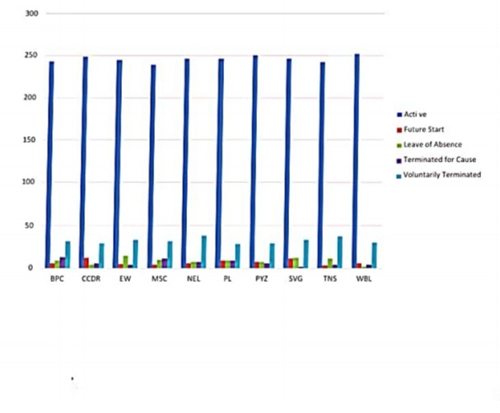
RESULTS
11

Slide 12
conclusion
In summary, a comprehensive conclusion for a data analysis in a research study involves a strategic synthesis of key finding of the performance level of an each employee specifically and their implications, contribution to the organisation as a brief.

